Slide 1
Land Cover Change Detection (Deforestation)

Slide 2
Submitted by:
Viraj Hirpara 202319003
Piyush Pandya 202319023
Harsh Velani 202319025
Parth Patel 202319007
Deep Rabadiya 202319029
Submitted to:
Dr. Ranendu Ghosh
Dr. Viral Dave

Slide 3
INTRODUCTION
Land cover change detection is the process of identifying and quantifying changes in the Earth's land surface over time. It is a critical tool for understanding and managing environmental and ecological systems.
Land cover changes can be caused by a variety of natural and anthropogenic factors, including deforestation, urbanization, agriculture, climate change, and natural disasters.
Land cover change detection involves comparing data from satellite imagery or other remote sensing data from different time periods to identify areas where the land cover has changed.

Slide 4
Project Objective:
To map and monitor land cover changes in Arunachal Pradesh, India, from 2000 to 2022.
To map and detect change using supervised classification algorithms in machine learning-based model

Slide 5
Importance
Monitor deforestation and forest degradation
Track urbanization and its impacts on the environment
Assess the expansion of agriculture and its effects on biodiversity
Study the impacts of climate change on land cover
Track the spread of invasive species
Monitor the effects of natural disasters on land cover
Inform land-use planning and decision-making

Slide 6
Data Collection
Data Source:
USGS Earth Explorer
Landsat 4/5 for 2000 and 2010
Landsat 8 for 2022
Cloud Free Imagery: Minimizing cloud cover to <10%
Multispectral Band with Resolution 30m.
USGS Earth Explorer

Slide 7
Data Preprocessing and Data Preparation
Stacking
Mosaic
Clipping
Subset

Slide 8
Feature Extraction and Preparation
Feature extraction is a crucial step in land cover change detection, as it involves transforming raw satellite image data into a more meaningful and interpretable representation that can be effectively utilized by machine learning algorithms.

Slide 9
Data Preparation for Supervised Classification in ML
Feature normalization is an essential step in feature preparation for machine learning algorithms. It involves scaling features to a common range, ensuring that all features have a similar order of magnitude. This is particularly important when dealing with features that have different units or scales.
Choosing the Appropriate Normalization Technique
Applying Z-score normalization to subset image’s data
Converting categorical data into numerical representation in points feature’s data (label encoding)
Applying Z-score normalization to points feature’s data

Slide 10
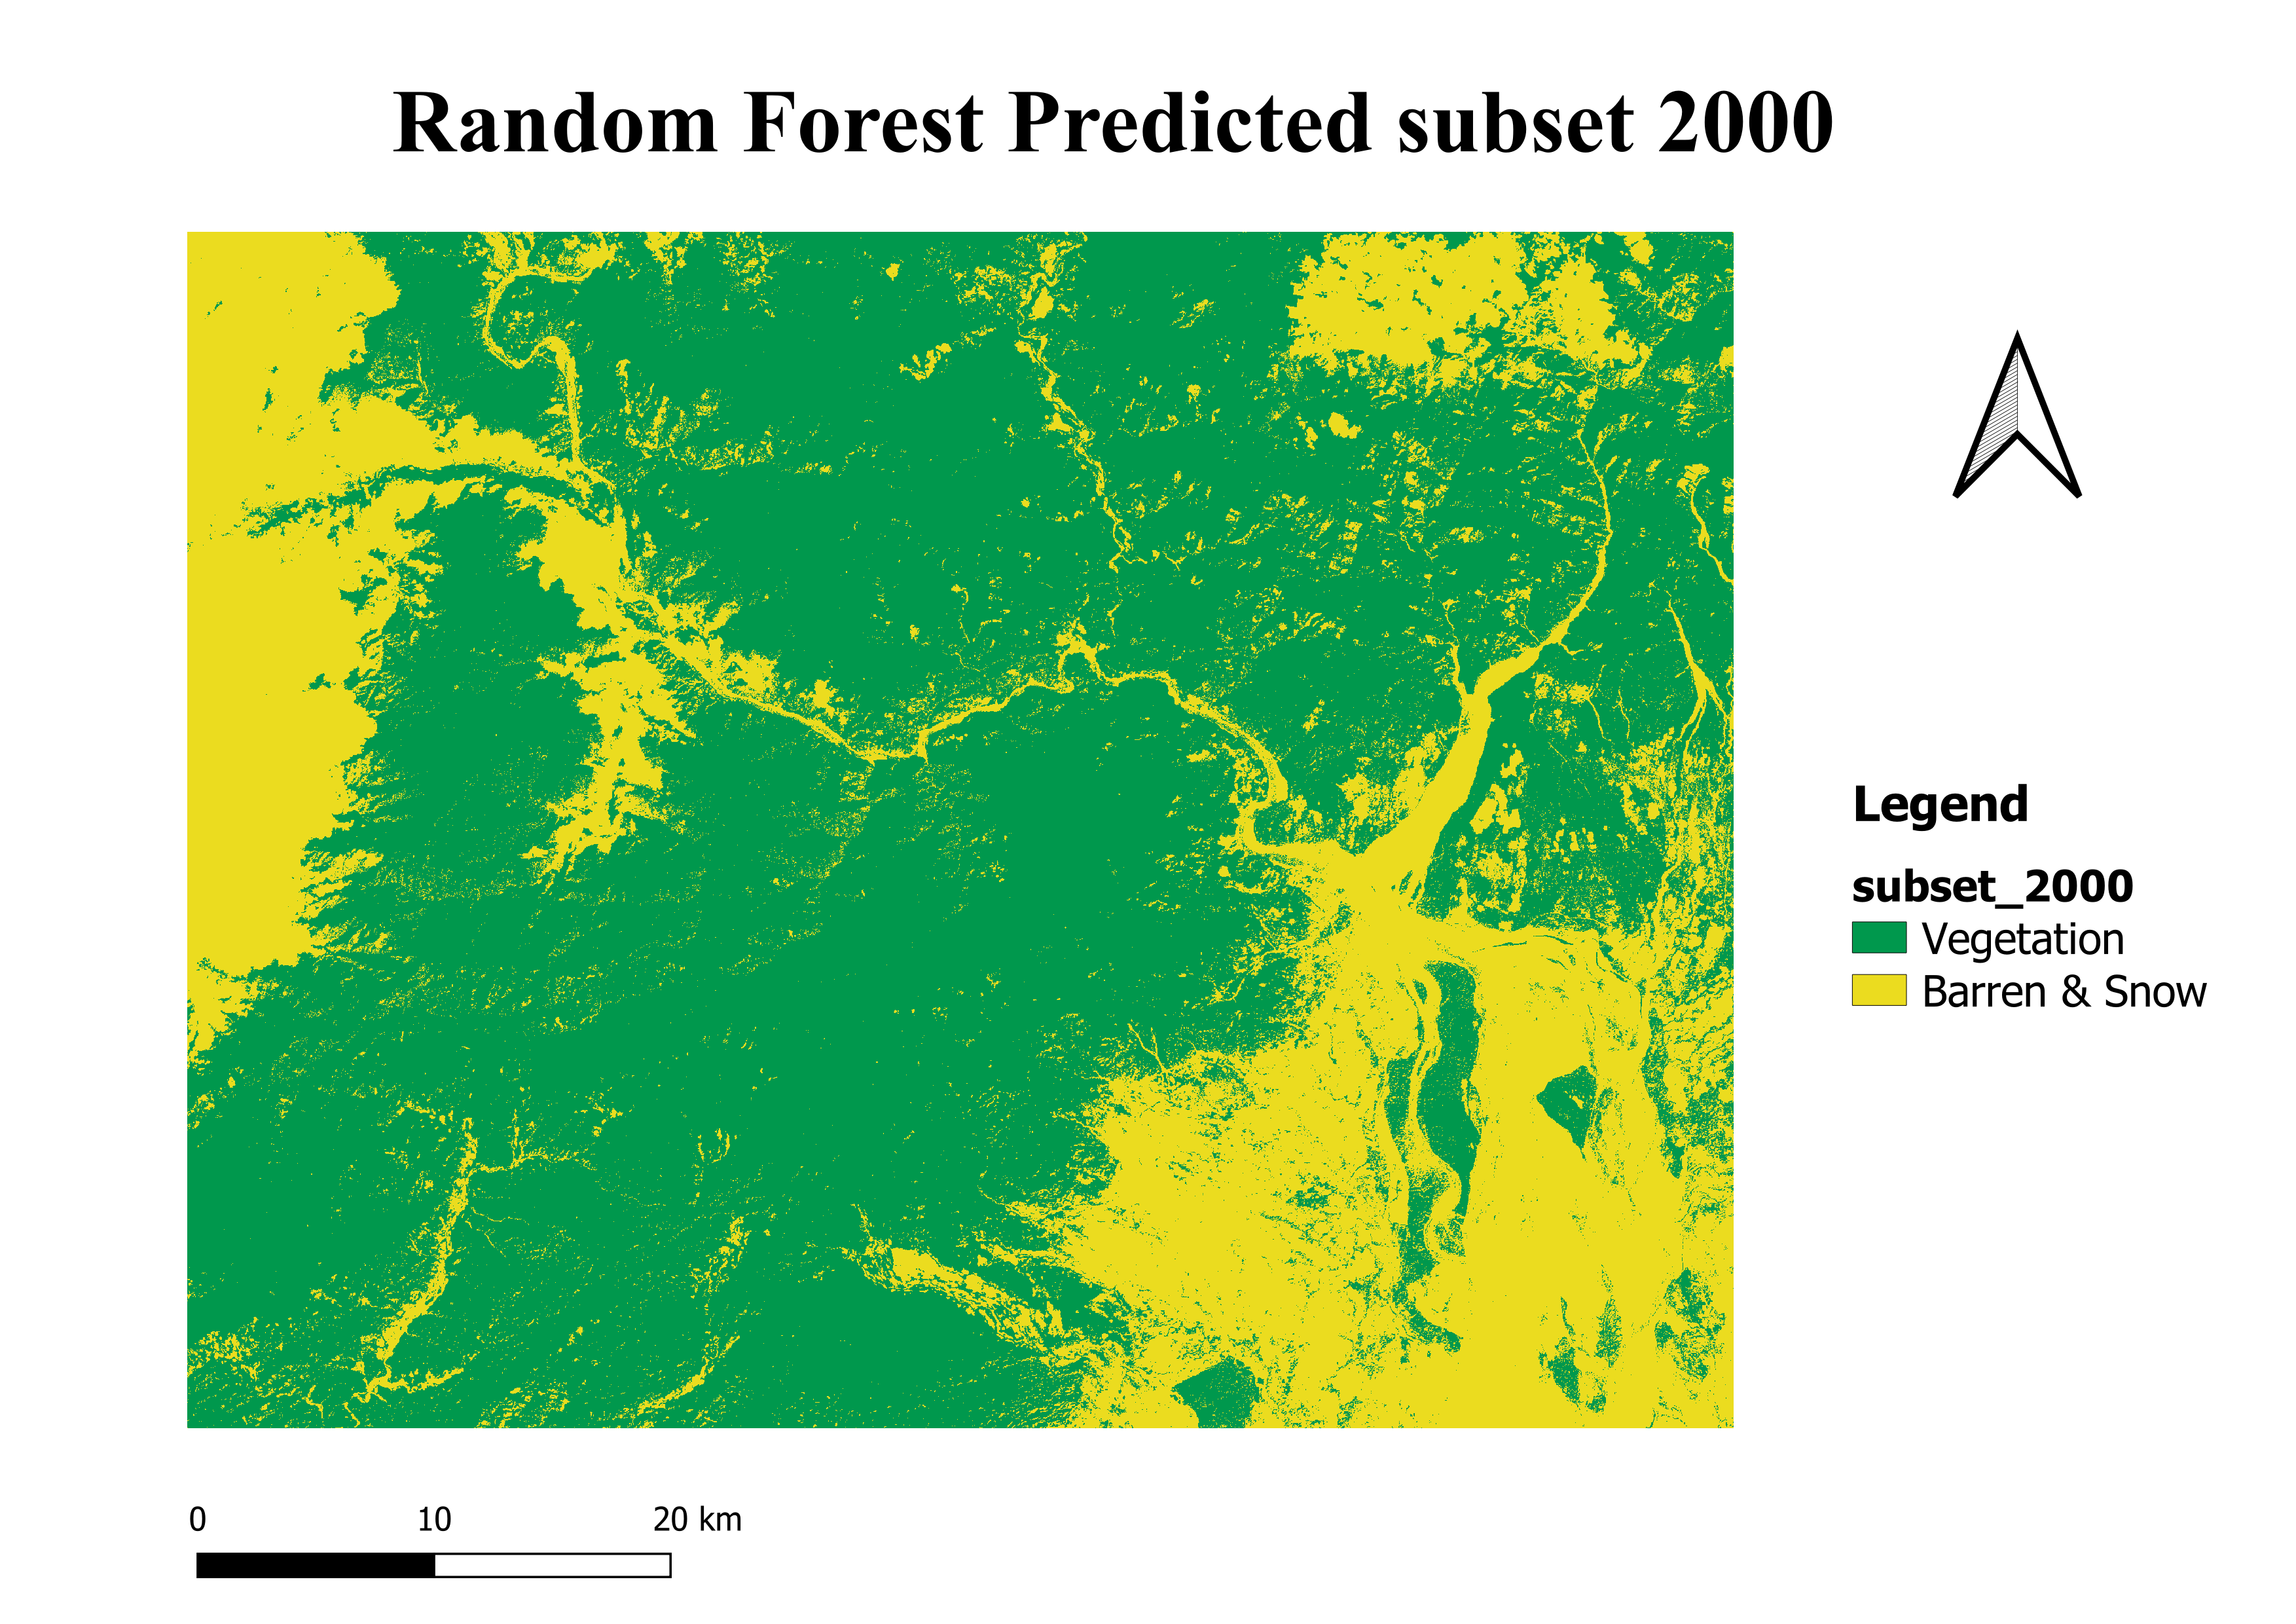
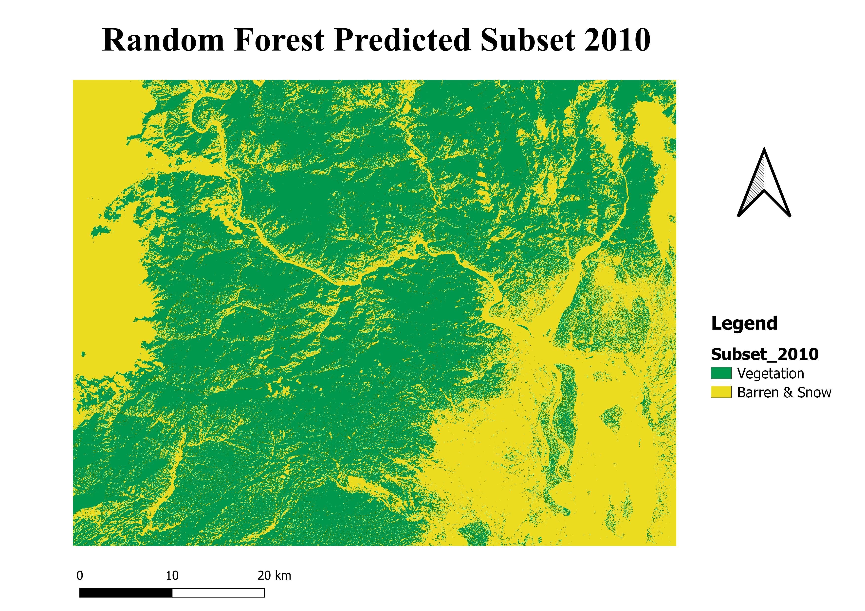
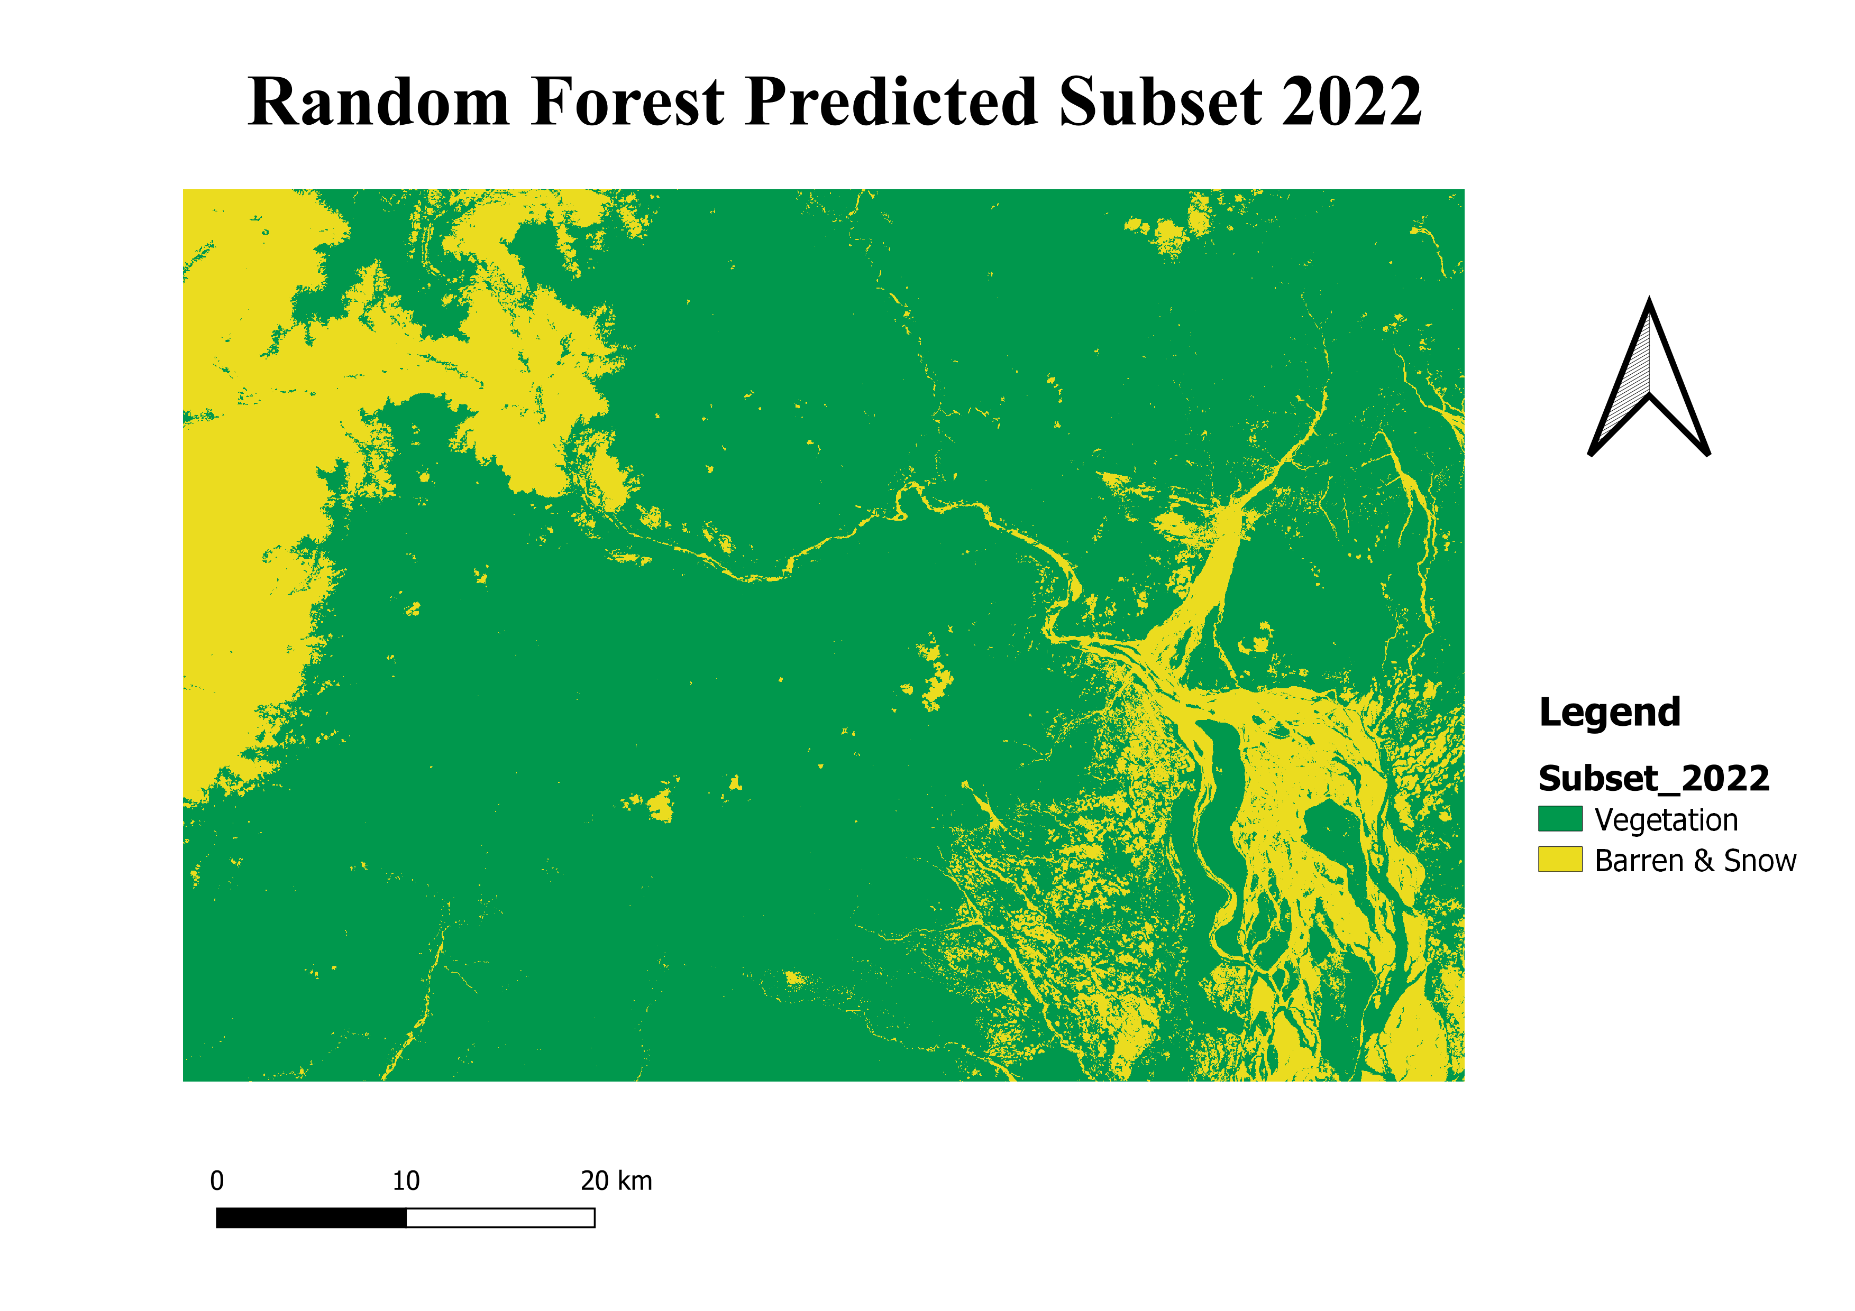
Map of Subsets generated Using Random Forest Classifier

Slide 11
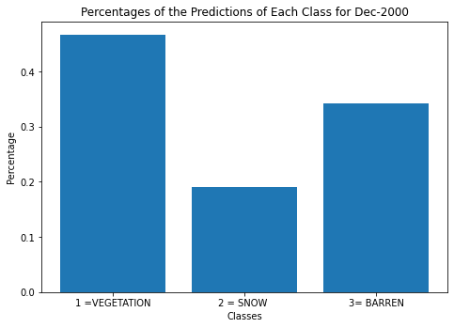
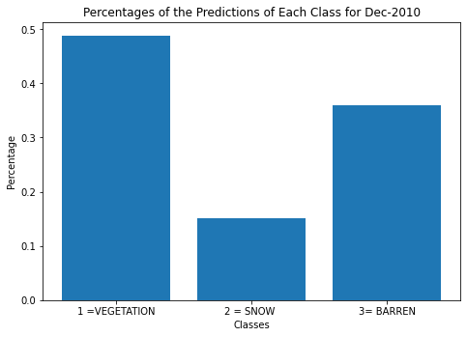
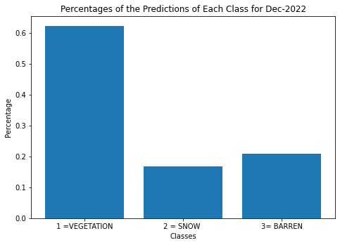
Bar Plots Of Classified Areas based on Classes

Slide 12
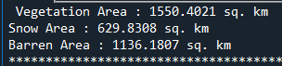
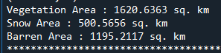
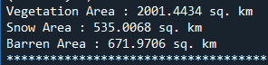
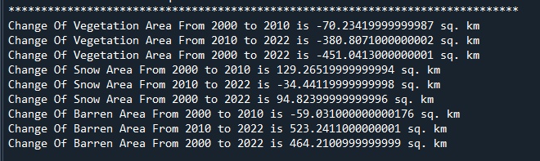
Change Analysis
Area of Subset 2000
Area of Subset 2010
Area of Subset 2022
Change in Area Based on Classes

Slide 13
Unsupervised Classification Using ERDAS
Imported Clipped Image
Raster Function
Unsupervised Classification
Used K-mean algorithm
No. of Class : 10
Labelled Each Classes in Attribute table
Recoded Particular Area based on Classes
Repeated same process other two images
Each Class was encoded with colors
Made Map Layouts including Legends, Scale, etc.
In Raster Function
Thematic
Matrix Union
Generated the Final Images

Slide 14
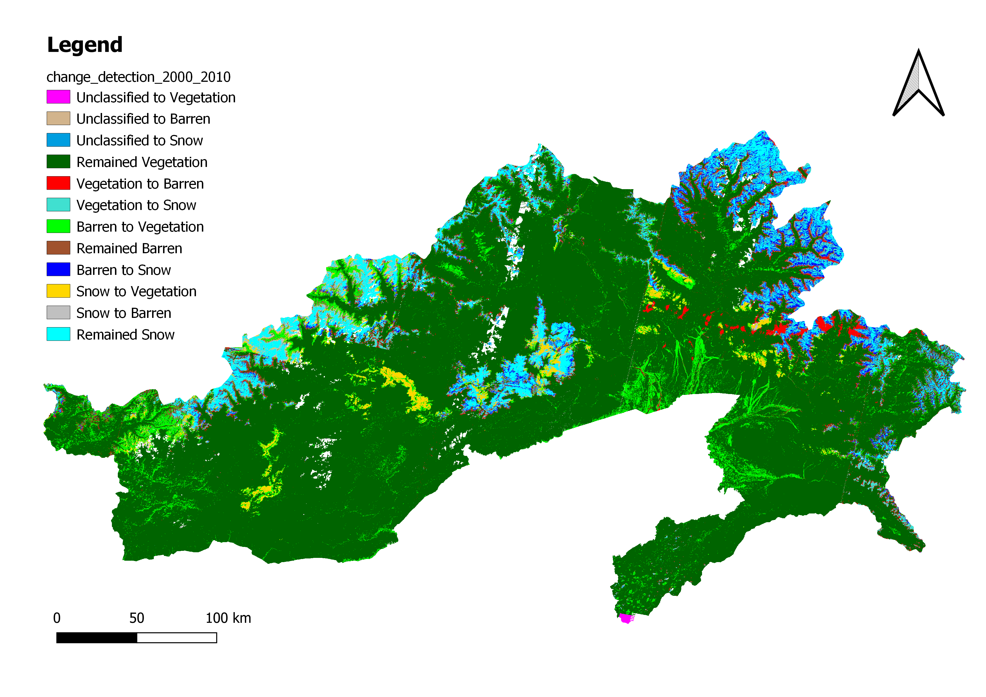
Land Cover Detection 2000 to 2010

Slide 15
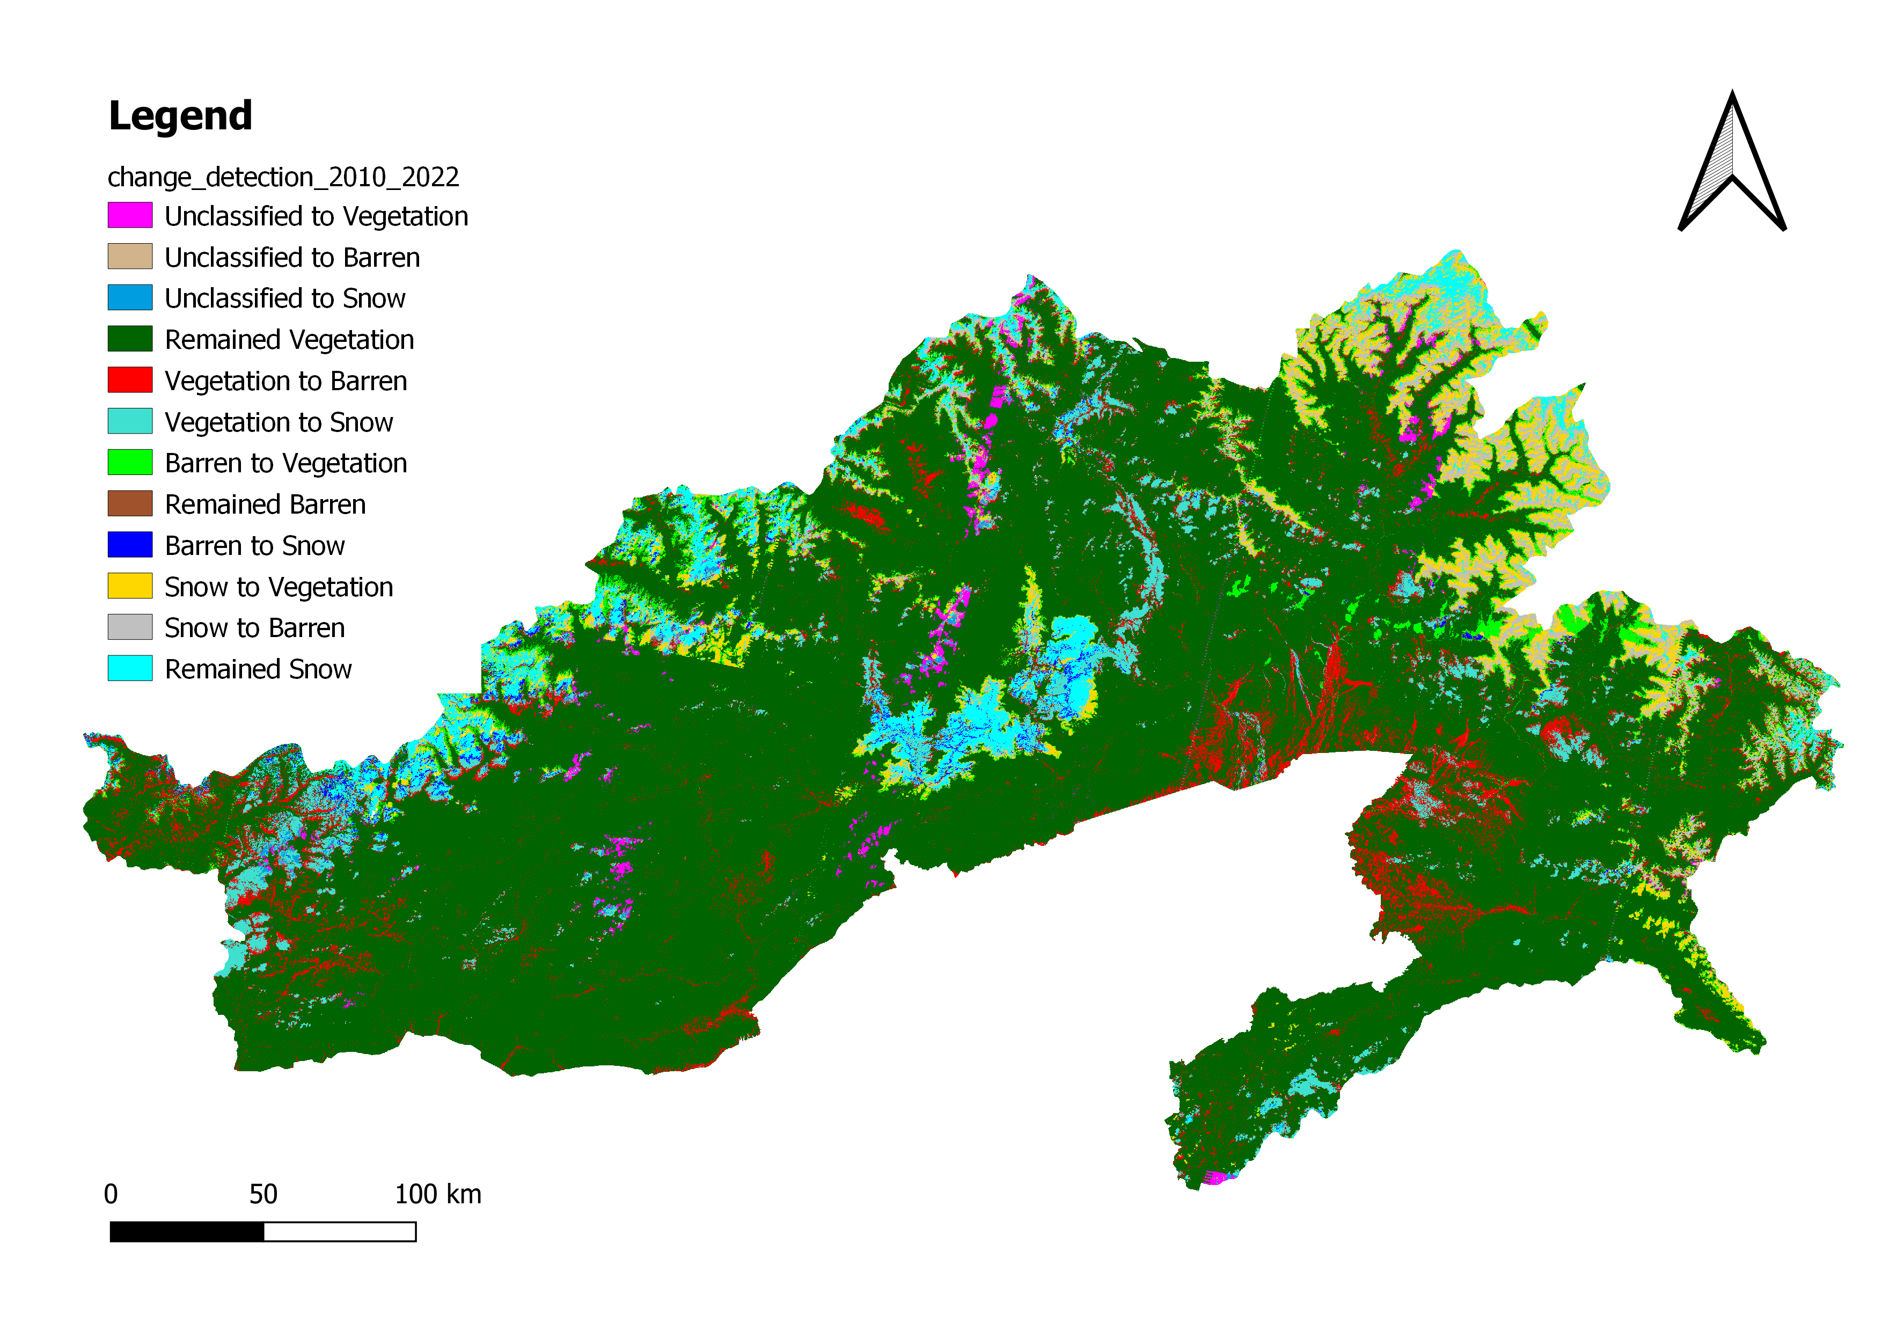
Land Cover Detection 2010 to 2022

Slide 16
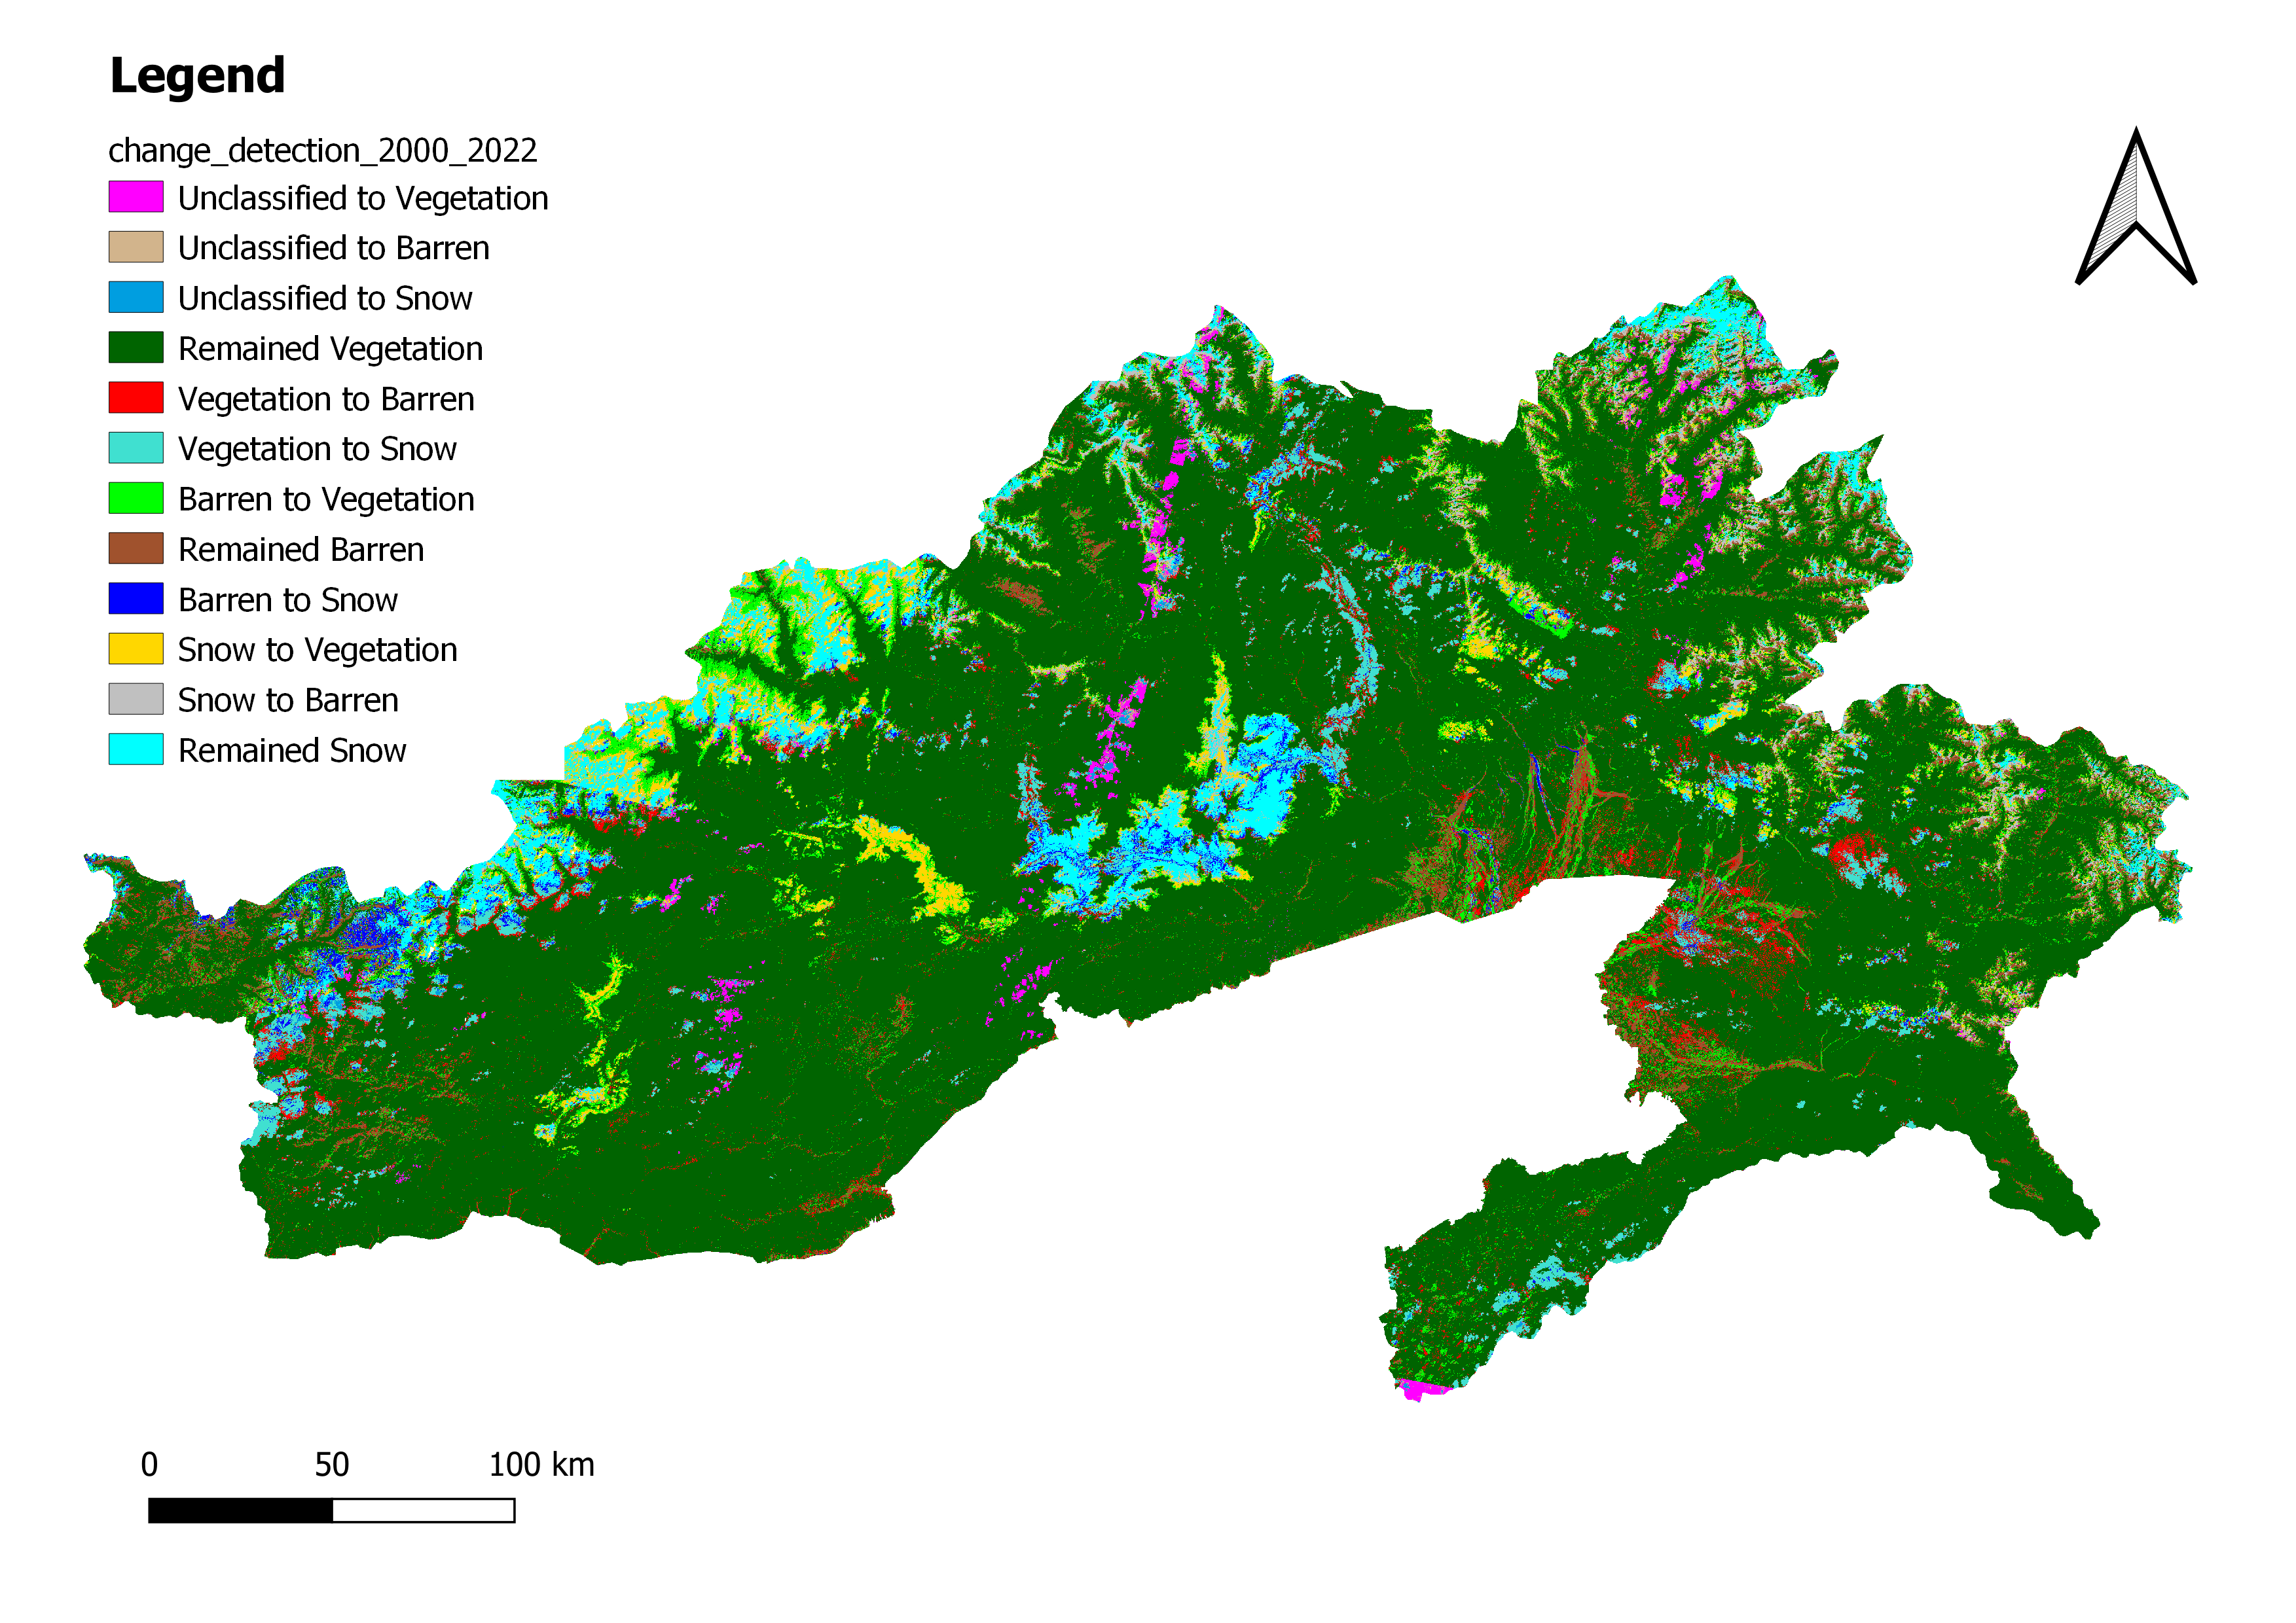
Land Cover Detection 2000 to 2022

Slide 17
Conclusions
From Random Forest Classifier:
Observed that Vegetation Area increases over the time from 2000 to 2022.
Snow area decreased from 2000 to 2010 but again increased from 2010 to 2022 and Overall decreased from 2000 to 2022.
Barren Area increased from 2000 to 2010 but decreased at large extent from 2010 to 2022 and Overall decreased from 2000 to 2022.
From ERDAS :
Vegetation Area increased from 2000 to 2010 but decreased from 2010 to 2022.

Slide 18
Thank you!

